Slide 1





Presentation On
STUDENTS SOCIAL MEDIA
ADDICTION ANALYSIS
Presented By
Asutosh Khatua
Ankita Mitra
Abhilash Prasad Sahoo
Simran Sahoo
Hitesh Kumar Rout
Swetalana Parida

Slide 2

INTRODUCTION
Students’ social media addiction is a growing concern that affects academics, mental health, and social life. By analyzing usage patterns and engagement, researchers can understand how excessive use impacts focus and well-being.
This analysis helps uncover trends that guide educators, policymakers, and mental health experts to design awareness programs, digital detox plans, and support systems for healthier online habits.

Slide 3

OVERVIEW
The dataset includes detailed information about each student’s social media usage, such as daily screen time, time of usage, platforms accessed, and the type of content consumed. This metadata is essential for categorizing and analyzing online behavior.

Slide 4

ADVantages
Detailed information about students’ daily screen time, app usage frequency, and active hours enables a thorough understanding of their digital habits and addiction levels.
Comprehensive data on activities like scrolling, posting, liking, commenting, and sharing helps analyze patterns of engagement and potential signs of dependency.

Slide 5
DISADVANTAGES
The vast amount of social media activity data can be overwhelming and complex to monitor, requiring significant time, resources, and advanced analytical skills to interpret accurately.
Self-reported usage data or app-tracked data might be incomplete or inaccurate, leading to gaps that hinder comprehensive analysis and may result in biased or misleading conclusions.
CREATIVE DESIGN
Handling student data involves privacy and ethical concerns, requiring strict adherence to data protection policies to prevent misuse and ensure students’ confidentiality and consent.
The rapidly changing nature of social media trends means that usage patterns can shift quickly, necessitating continuous monitoring and real-time updates to keep findings relevant.

Slide 6

PROBLEM STATEMENT
In the rapidly evolving digital age, understanding students’ social media usage patterns and their impact on academic performance and mental well-being is crucial for educators, parents, and policymakers. However, the vast and complex nature of social media data presents significant challenges. This research must analyze detailed information on screen time, app preferences, engagement activities, and behavioral patterns. The sheer volume and constantly changing nature of students’ online interactions can be overwhelming to monitor and interpret. Additionally, issues like self-reported inaccuracies, privacy concerns, and ethical considerations further complicate the analysis.
FOLLOWING ARE NEEDED TASKS FOR THE DEVELOPMENT OF THE ALGORITHM:
Collect and preprocess student social media usage data.
Analyze and categorize behavioral patterns and risk levels of addiction.
Develop and test awareness or intervention strategies to reduce excessive usage.

Slide 7

WHAT DOES IT PREDICT ?
This step involves collecting students’ social media usage data, cleaning it, and preparing it for analysis. Preprocessing might include removing inconsistencies, normalizing screen time data, and extracting relevant behavioral indicators.
After analysis, the model predicts the likelihood or severity of social media addiction among students. Techniques such as clustering, classification, and cross-validation can be used to ensure the model’s accuracy and reliability.
It can predict risk levels and possible impacts on academic performance, mental health, and social well-being, helping educators and counselors design targeted awareness or intervention strategies.

Slide 8
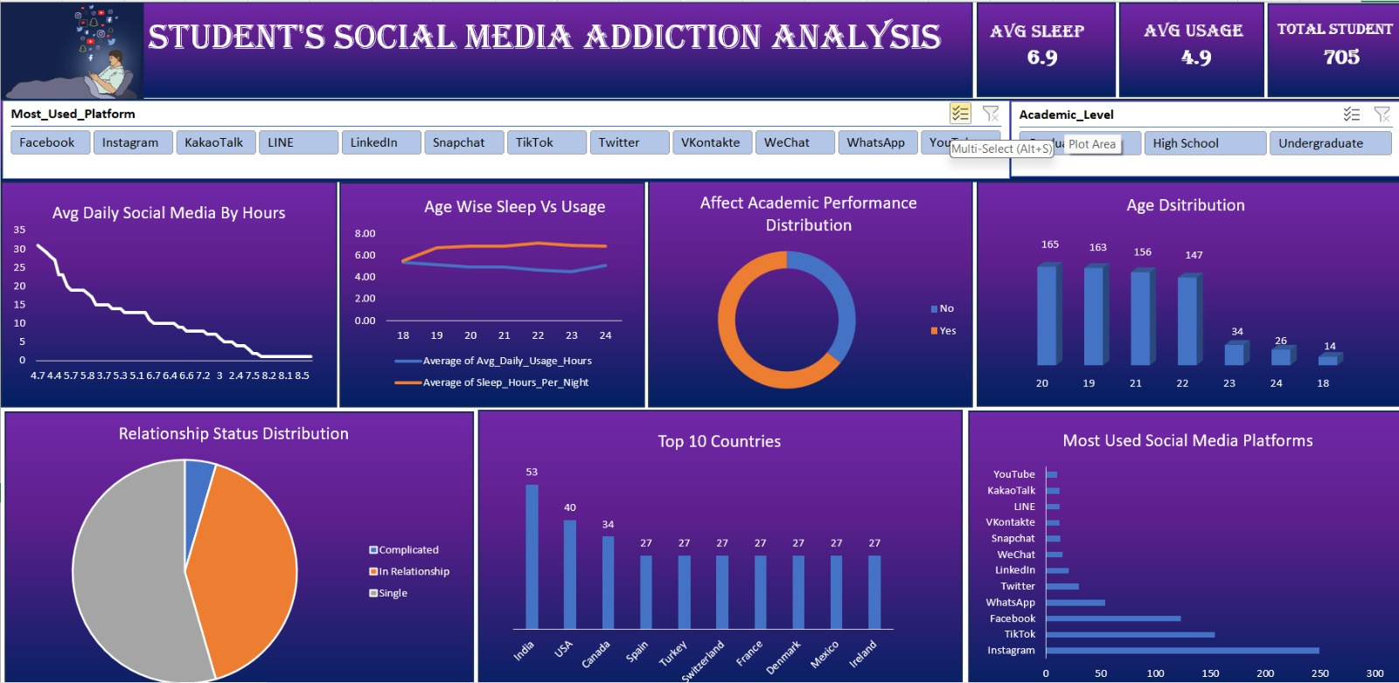
EXCEL DASHBOARD

Slide 9
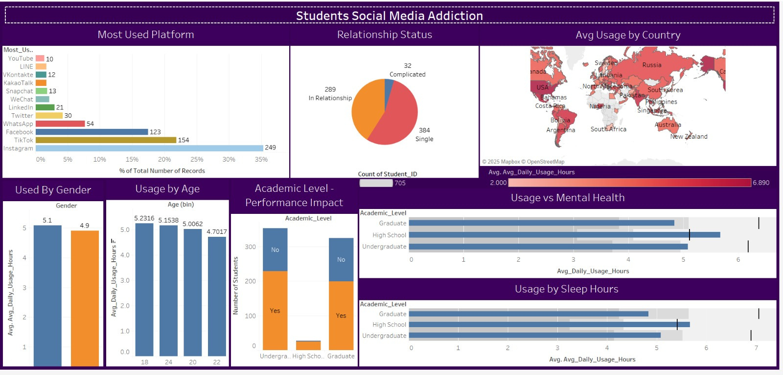
TABLEAU DASHBOARD

Slide 10

CONCLUSION
Based on the analysis of students’ social media usage, several key insights emerge. Patterns show that excessive time spent on social platforms can negatively affect focus, academic performance, and mental health. Frequent late-night usage and long screen time durations are common, highlighting the need for better digital discipline and awareness among students. The analysis shows that entertainment and social interaction are the main drivers of excessive use, with notifications and peer influence significantly contributing to addictive patterns. The findings emphasize the importance of digital well-being education, parental guidance, and self-regulation tools to help students balance their online and offline lives effectively.

Slide 11
THANK YOU
Please get in touch with us if you have questions or need clarification on our team's presentation.

